Slide 1
Overview of Project Formula Fighters COMP.4110 - Software Engineering University of Massachusetts Lowell Fall 2023
Team members:
Forrest Boyer
Kyran Chan
Tameron Honnellio
Anson Lu
Will Shahbazian
Instructor: Dr. James Daly
Notes:
‹#›

Slide 2
Project Overview
Engaging Entertainment
Motivation for project
Epidemic of low attention spans among students
Lack of educational deck-builder games
Notes:
‹#›

Slide 3

Overview of Features
Playable Cards
Random Map Generation
Progression Between Levels
Notes:
‹#›

Slide 4
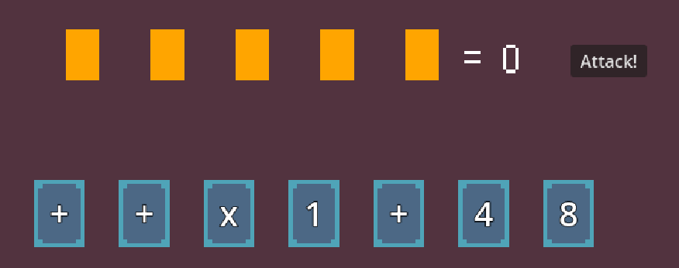
Playable Cards
Draggable Cards
Representing Numbers and Operators
Used to create equations to interact with the game
Notes:
‹#›

Slide 5
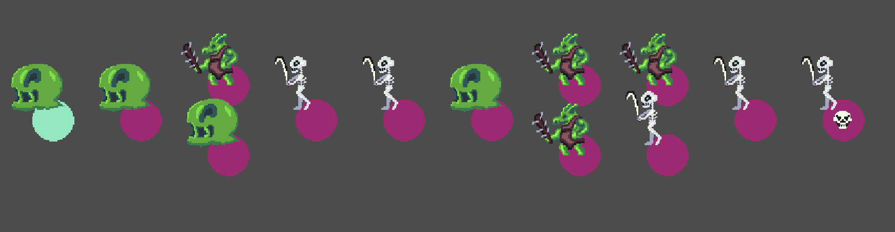
Random Map Generation
Random Generation for replayability
Random map layouts
Randomly generated enemy and backgrounds
Notes:
‹#›

Slide 6
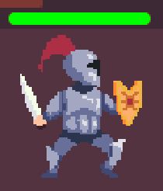
Progression Between Levels
Level Progression
Map: contains access to all levels
Used to maintain the progression scheme
The player can collect cards as they progress
Notes:
‹#›

Slide 7
Domain Research
Learned Godot Game Engine from scratch
Needed to apply domain knowledge on game development.
Project Constraints:
Time: 11/6 - 12/11/2023
Experience: previously none
Software Limitations: Godot G.E.
Notes:
‹#›

Slide 8
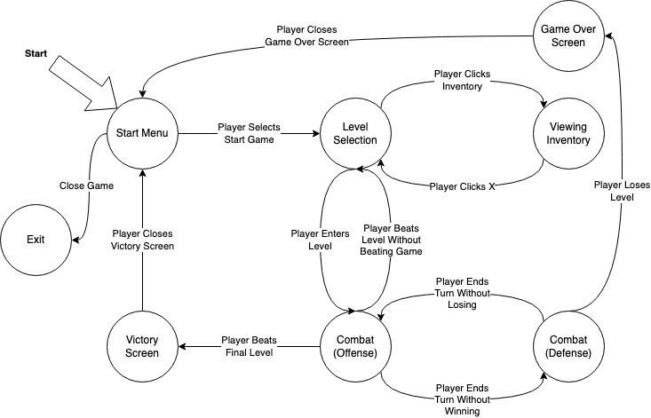
Game State Diagram
Notes:
‹#›

Slide 9
Sample Scenarios
Notes:
‹#›

Slide 10
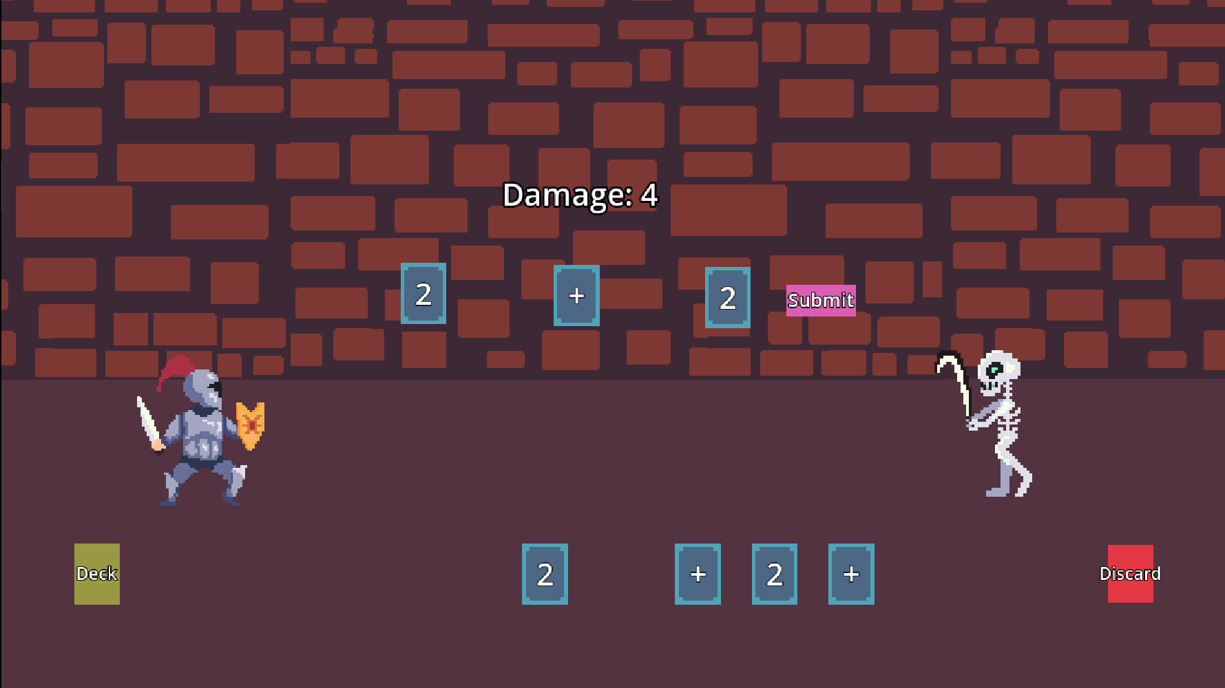
Level Combat
Notes:
‹#›

Slide 11
Level Selection
Notes:
‹#›

Slide 12
Demonstration Video
(placeholder slide for now)
Notes:
‹#›

Slide 13
Acknowledgements
• We gratefully acknowledge and appreciate the participation of our customer, Professor Daly from University of Massachusetts Lowell

